Slide 1
Potential Strategies to
Minimize Rate Increases
While
Maintaining Property Coverages for
Your Association

Slide 2
Changes to Insurance in the Marketplace
Who?
All Carriers
What?
Association Coverage
When?
Right Now
Where?
Countrywide, Florida more than others
Why?
Reinsurance Costs, Catastrophe Losses, Increase Demand, Less Supply

Slide 3
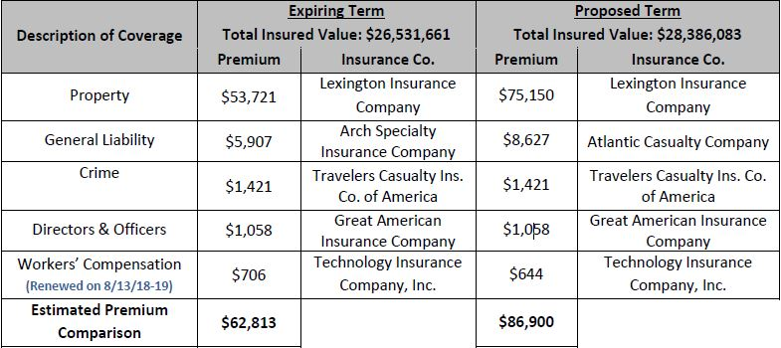
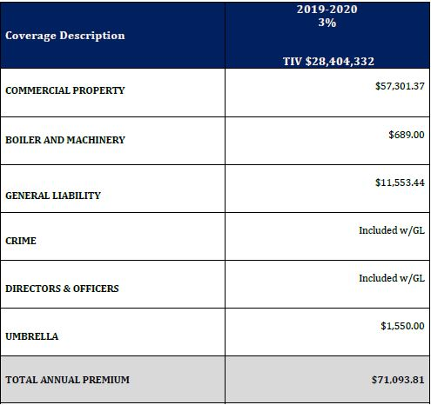
Examples of Change in Insurance Premiums
Insurance Proposal by Agent - “Jake from Slate’s Barn”
Insurance Proposal by CAI of Florida
*Policy Exclusions – Mold, Mold Liability, Assault & Battery, Liquor, Animal Liability, Docks & Seawall

Slide 4
Changes in Insurance Coverage
Ordinance & Law
Mold, Fungi & Bacteria
Water & Sewage Back-up
Wind-Driven Rain
Mold Liability
Liquor Liability
Assault & Battery
Docks & Seawalls
Deficient Directors & Officers Coverage

Slide 5
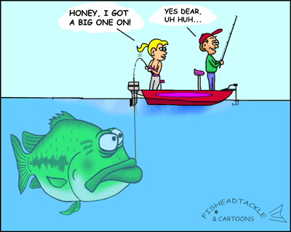


Apples Versus Oranges
  “We All Fish from the
  Same Pond???”
  1. We all don’t use the same bait
  2. We aren’t equipped with the
  same tackle box

Slide 6
Strategies to Combat Rate Increases & Decreases in Coverage
Tackle Box
Loss Control Survey
ERP & Disaster Plan
Aerial Drone Site Survey
Hurricane Site Survey
Unit Owner University & Education
Pre-Mitigation Evaluation
Post Loss Claims Advocacy

Slide 7
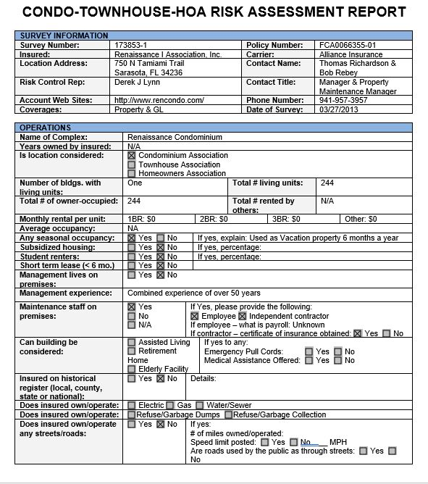
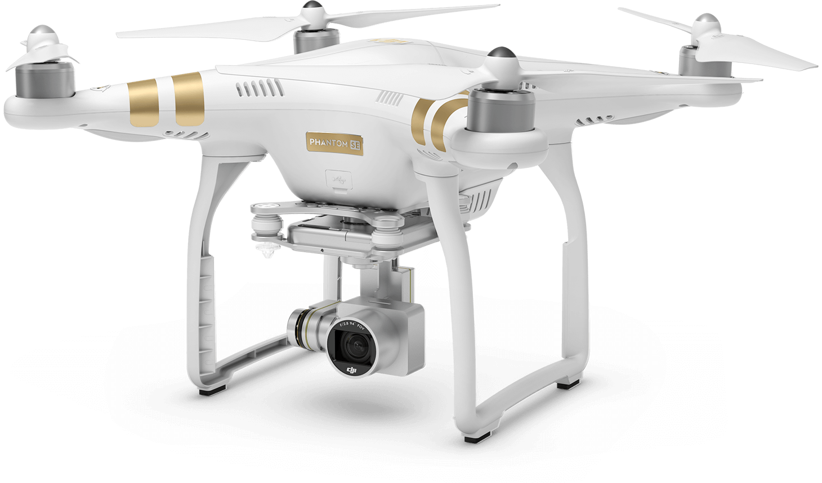
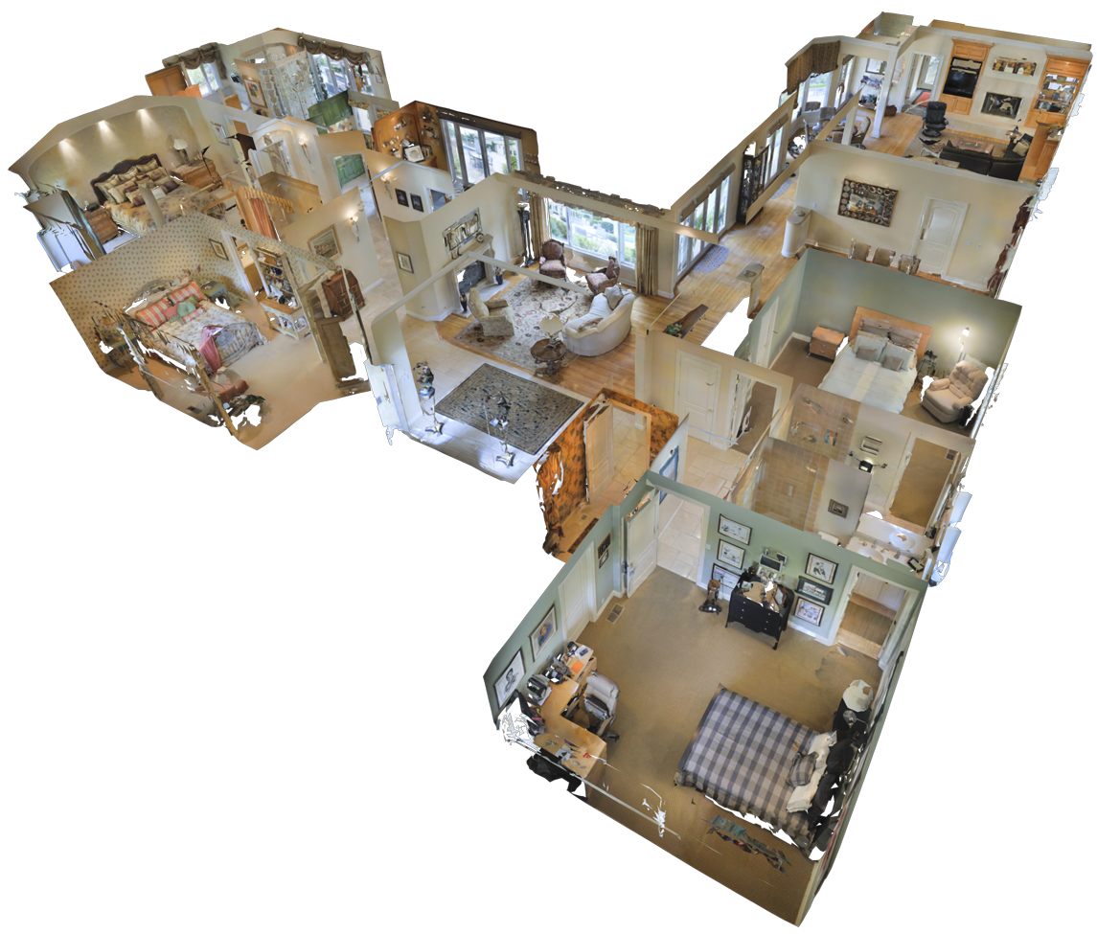
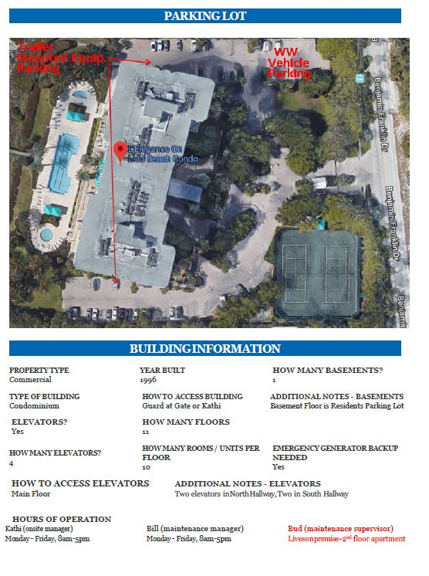
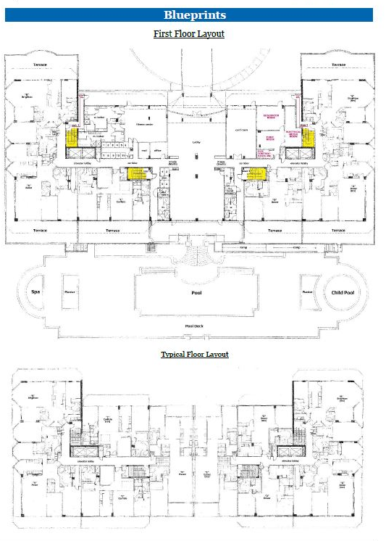
Examples of Risk Management Tools
Risk Assessment Report
Emergency Response/Disaster Plan
&
Aerial Drone Site Survey
3D Pre-Mitigation Evaluation
&
Property Documentation

Slide 8
Reserve Studies
One of the Most Under-Utilized Tools for an Association
Why?

Slide 9

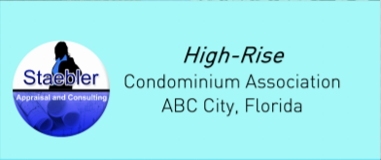

Slide 10
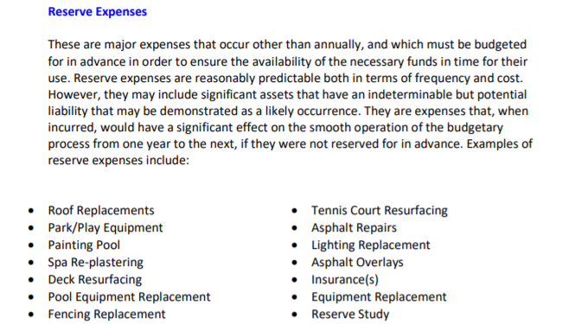

Slide 11
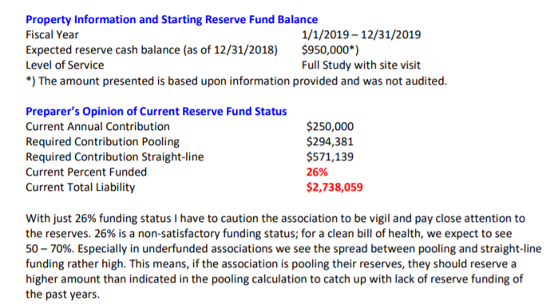

Slide 12
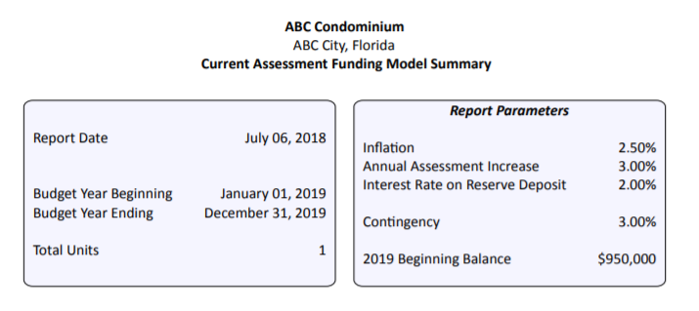
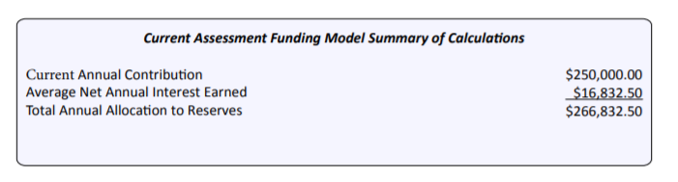

Slide 13
